Slide 1
13 Places to visit in Portugal, from North to South

Slide 2
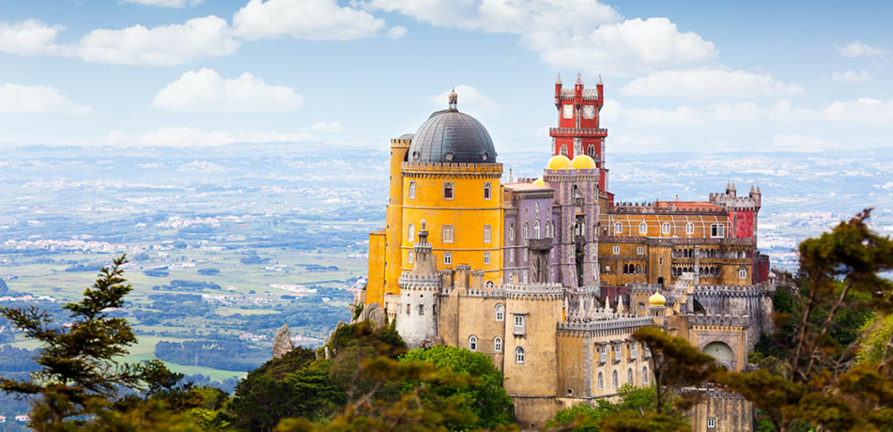
Portugal was considered the best tourist destination in the world by the World Travel Awards, surpassing countries like Thailand, sought after by the whole world for its so inviting prices.
Portugal is fashionable and, best of all, is a destination fit for virtually every budget.

Slide 3
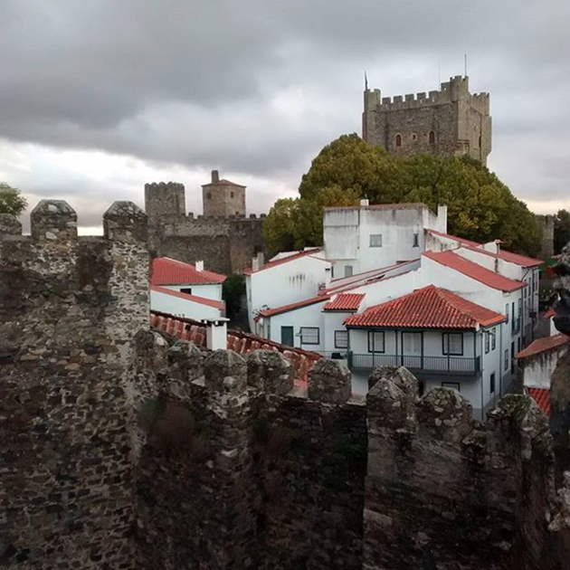
1. Begin by traveling to the middle ages visiting the castle and the citadel of Bragança, a small well-preserved village with picturesque white houses located within the walls.
Take the opportunity to climb the walls of the castle to enjoy the view of the four mountain ranges that surround it: Serra da Nogueira, Serra de Rebordões, Serra de Sanabria and Serra de Montesinho.

Slide 4
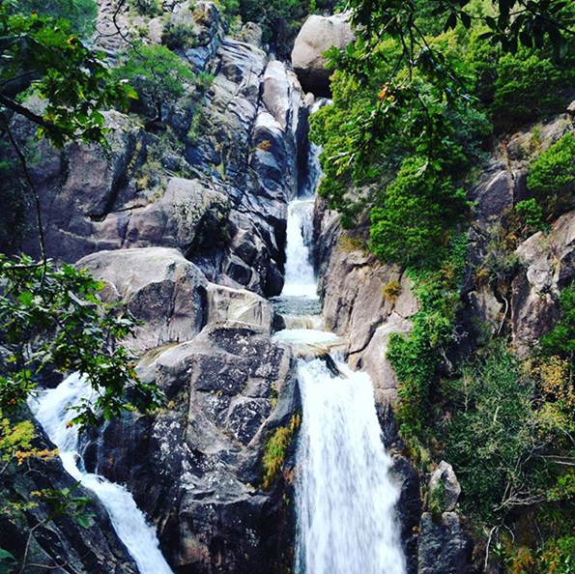
2. Spend a day in contact with nature in the National Park of Peneda Gerês, considered as a World Biosphere Reserve by UNESCO.
Leave the clock in your backpack, part to the discovery of its granite villages, lose yourself between paths and do not be surprised if you find some wild boar, otters, deer or ponies on the way.

Slide 5
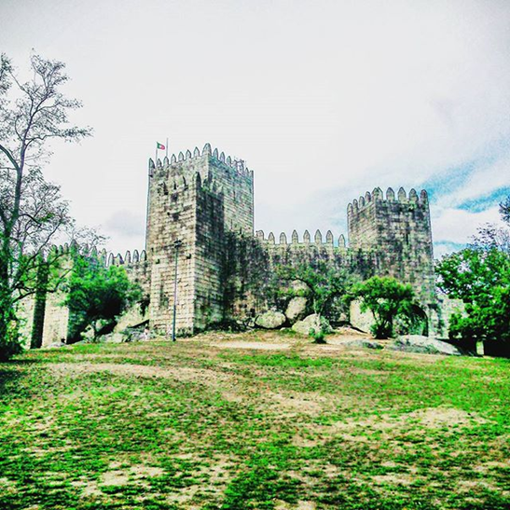
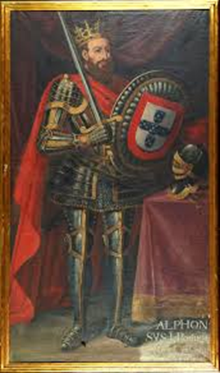
3. Go now to the Castle of Guimarães, where was born the first king of Portugal, D.Afonso Henriques, in 1112.
Guimarães Castle hours are from 10:00 a.m. to 6:00 p.m. and it is open every day. Admission costs € 2 for adults and € 1 if you have a student / youth card or over 65 years. Admission is free at the castle for children under 12 years.

Slide 6
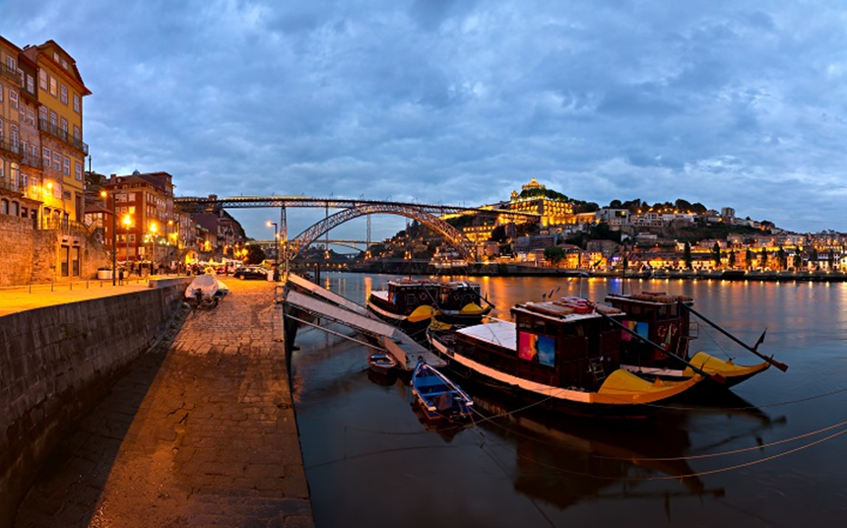
4. Those who travel in the North of Portugal can not miss the unforgettable Invicta City. Enjoy a delicious Port wine on a terrace with views of the Douro.

Slide 7
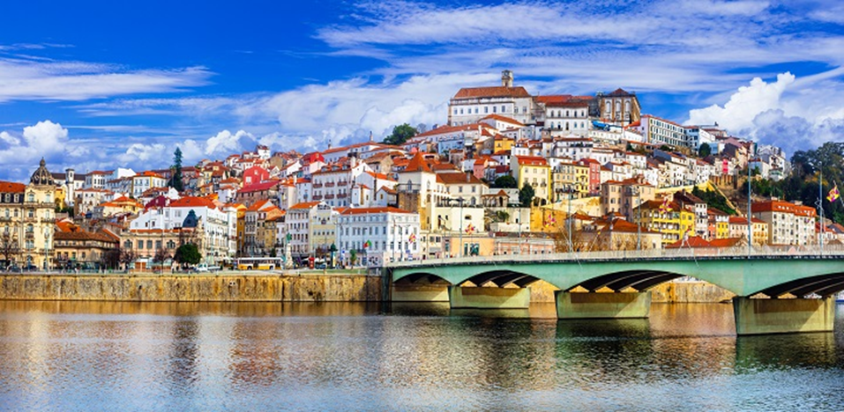
5. Prepare to enter an authentic temple of wisdom. Founded in 1290, the University of Coimbra continues to be one of the most important academic centers in the country and here are some of the most important Portuguese intellectuals such as Luís de Camões, Eça de Queirós or Almeida Garrett.

Slide 8
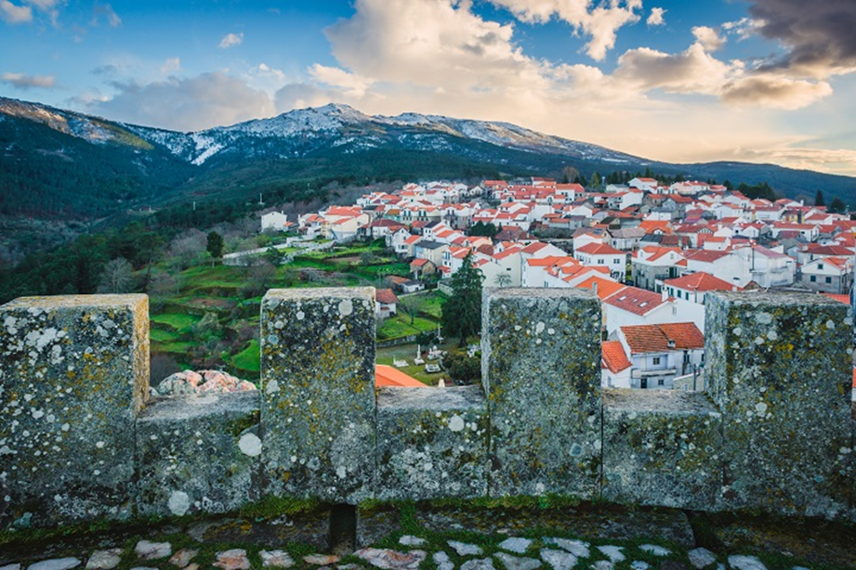
6. Spend a day in the Serra da Estrela, discover its historical and picturesque villages, enjoy the landscape and take the opportunity to visit the Tower, the highest point of continental Portugal with 1,993 meters.

Slide 9
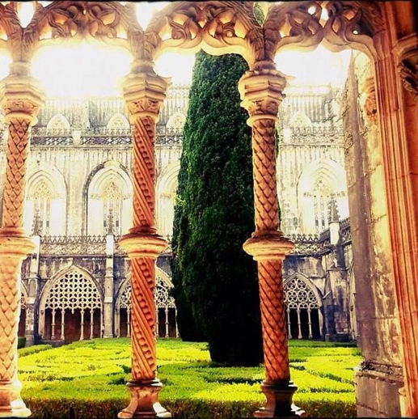
7. One of the monuments that definitely deserves a visit. Considered a World Heritage Site by UNESCO and included among the Seven Wonders of Portugal, the Monastery of Batalha is a notable example of Late Gothic Portuguese architecture or Manueline style.
A normal entrance at the Monastery of Batalha costs € 6. Admission is free on Sundays and public holidays until 2:00 p.m.

Slide 10
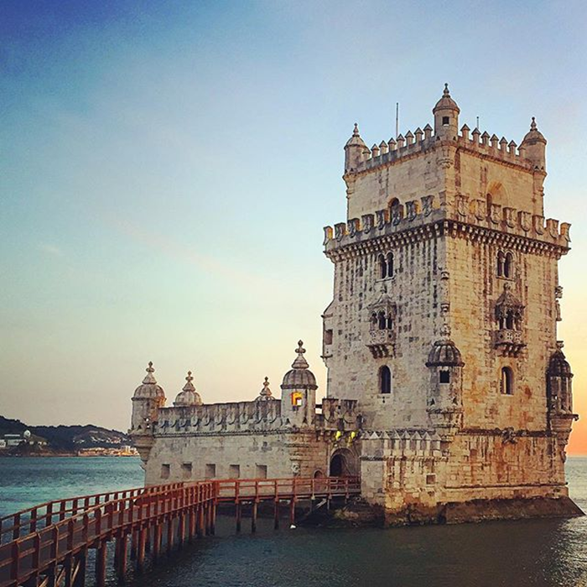
8. Another symbol of Lisbon: the Tower of Belém.
Acerca do Google TradutorComunidadeTelemóvelAcerca da GooglePrivacidade e Termos de UtilizaçãoAjudaEnviar comentários e opiniões
Classified as a World Heritage Site by the United Nations Educational, Scientific and Cultural Organization (UNESCO) since 1983, it was elected as one of the Seven Wonders of Portugal on July 7, 2007.
In 2015 it was visited by 608 thousand tourists.

Slide 11
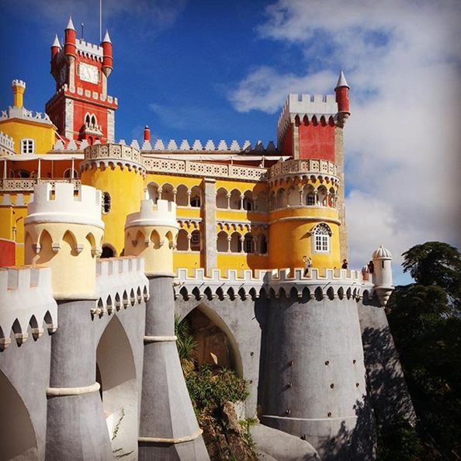
9. Dedicate a day of your trip to discover the beautiful city of Sintra. Walk to the castle, enter the colorful Pena Palace, visit the gardens of Seteais, eat some queijadas and discover why several writers (such as Eça de Queirós, Lord Byron or Hans Christian-Adersen) used this village as a refuge and source of inspiration.

Slide 12
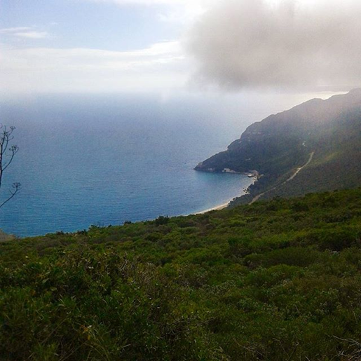
10. Head for the Natural Park of Arrábida, located between Setúbal and Sesimbra. And for a really unique experience, go to the Sado Estuary and take a boat trip to observe the dolphins that inhabit these waters.

Slide 13
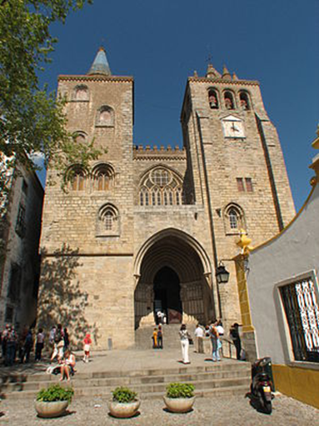
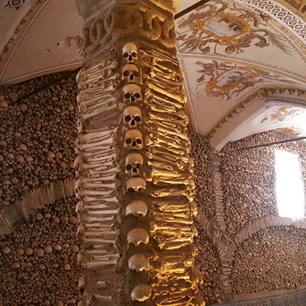
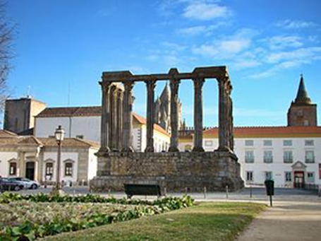
11. Also known as the "City-Museum" of the Alentejo, Évora, deserve special attention the Temple of Diana, the Cathedral and the Chapel of Bones, "decorated" with thousands of bones and skulls.

Slide 14
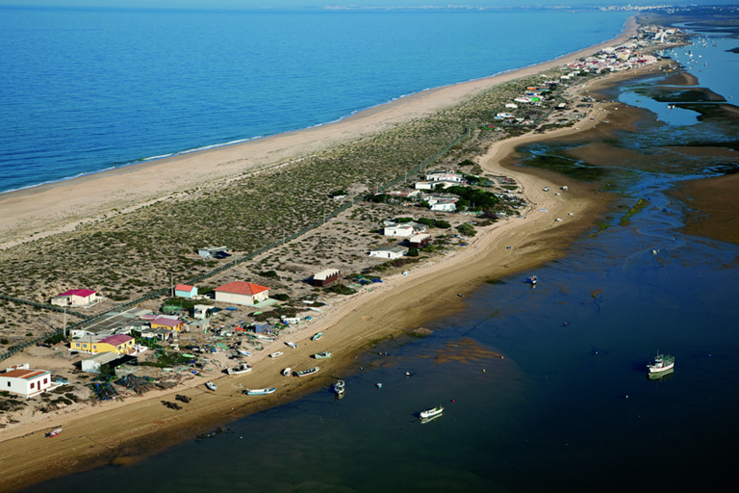
12. Nature reserve since 1978, it was in 1987 that it became a natural park. The Ria Formosa contains a significant biodiversity and covers 60 km in length and more than 18 000 ha in total.

Slide 15
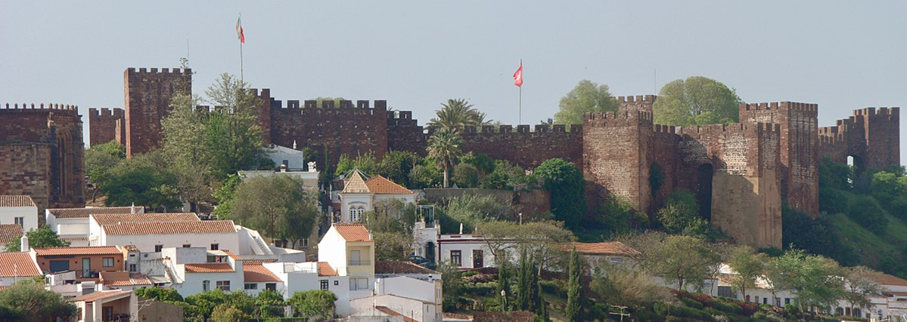
13. Built between the 7th and 10th centuries by the Moors, its particular architecture is witness to the presence of the Muslim people. The castle, also called the "red fortress" because of its color, is at the top and facing the city of Silves.

